Slide 1

"Crypto Crystal Ball: Using Machine Learning to Forecast the Price of Trending Digital Currencies"
Guided By:
Mr. Amay Manjrekar
Mr. Sanjay Sane
Submitted By:
Anisha Gupta (220943025006)
Raunak Mudgal (220943025032)
11/03/23
1

Slide 2

Outline
Introduction
Problem Statement
System Architecture
Data Pre-Processing
Methodology
PySpark with Mlib Algorithms
Data Visualization & Representation
Conclusion
Future Scope
References
27/01/20
2

Slide 3
Introduction
A cryptocurrency is a digital currency, which is an alternative form of payment created using encryption algorithms. The use of encryption technologies means that cryptocurrencies function both as a currency and as a virtual accounting system. To use cryptocurrencies, you need a cryptocurrency wallet.
Cryptocurrency such as Bitcoin are more popular these days among investors.
To predict the bitcoin price accurately, firstly , we identify the daily trends in the bitcoin price while gaining insight into the optimal features surrounding the bitcoin price. Secondly, using the available information, we will predict the sign of the daily price change with highest possible accuracy.
Data used in the project is structured in nature from year 2020.1 to 2021.5. It was collected from www.kaggle.com. To assess the accuracy of the developed prediction model and identify ways to improve its performance.This research uses Decision Tree Regressor, Random Forest Regressor, GBT Regressor, Linear Regression and K-Means.
27/01/20
3
Notes:
Hive and Hive QL statements have been used for querying the data.
For future scope, various different Machine Learning algo0rithm will be implemented on different flight delay datasets.

Slide 4

Problem Statement
To identify the most important features or factors that affect the price of cryptocurrencies and incorporate them into the prediction model.
To test the prediction model on historical data and assess its performance using metrics such as root mean square error.
27/01/20
4

Slide 5
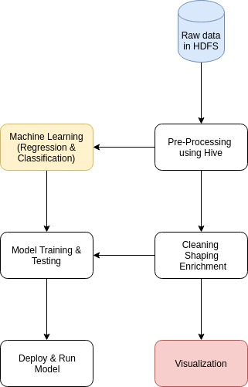
System Architecture
Fig: System Architecture of Analyzing And Predicting Outcome of IPL Data
27/01/20
5

Slide 6
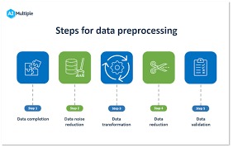
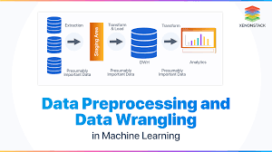
Data Pre-Processing
Missing values
Missing values in the type of delay columns are being dropped, indicating the cause is not valid.
Although, there are no null values in our data.
27/01/20
6

Slide 9
Methodology
Data Used :
Bitcoin Dataset- btc.csv(2020.1-2021.5)
Dumping the Data :
We dumped the data into HDFS
Data Filtering :
Cleaned & transformed the data in the format we can access it.
Storing the Data :
Retrieved it in Hive
Machine Learning Used :
Decision Tree Regressor, Random Forest Regressor, GBT Regressor,
Linear Regression and K-Means..
Visualizing the Data :
Visualised the data using Tableau
Fig: Process of Analysing And Predicting Outcome of Bitcoin Cryptocurrency Data
27/01/20
9

Slide 10
Machine Learning Algorithms
Random Forest Regressor :
(a) Ensemble of decision trees: Random Forest Regressor is an ensemble learning method that combines multiple decision trees to produce a more accurate prediction. Each decision tree in the forest is trained on a randomly sampled subset of the training data and a subset of the input features. The final prediction is the average of the predictions of all the trees in the forest.
(b) Large datasets: Random Forest Regressor can handle large datasets and can be easily parallelized using distributed computing frameworks such as Apache Spark.
2. Decision Tree Regressor :
(a) Decision Tree Regressor is a machine learning algorithm that uses a decision tree to predict continuous numerical values. In Apache Spark's Machine Learning Library (MLlib), you can use the Decision Tree Regressor algorithm to build a decision tree model.
(b) Decision Tree Regressor is a machine learning algorithm that uses a decision tree to predict continuous numerical values.
(c) Feature importance: Decision Tree Regressor provides a measure of feature importance, which indicates the contribution of each input feature to the prediction. Feature importance can be used to identify the most important features in the dataset and to perform feature selection.
.
27/01/20
10

Slide 11
3. GBT Regressor :
GBT Regressor is a gradient-boosted tree algorithm, which means it builds an ensemble of decision trees by iteratively adding trees that correct the errors of the previous trees. The algorithm minimizes the loss function by using gradient descent.
The most important hyperparameters of the GBT Regressor algorithm are the maximum depth of the tree (maxDepth), the maximum number of iterations (maxIter), the learning rate (stepSize), and the fraction of the dataset used for each iteration (subsampleRate). You can tune these hyperparameters to optimize the performance of the algorithm.
4.Linear Regression:
Linear regression uses the relationship between the data-points to draw a straight line through all them. This line can be used to predict future values. In the most simple words, Linear Regression is the supervised Machine Learning model in which the model finds the best fit linear line between the independent and dependent variable i.e it finds the linear relationship between the dependent and independent variable.
5.K Means
K-Means clustering is a popular unsupervised machine learning algorithm for clustering data. The algorithm works as follows to cluster data points: First, we define a number of clusters, let it be K here. Randomly choose K data points as centroids of the clusters.
27/01/20
11

Slide 12
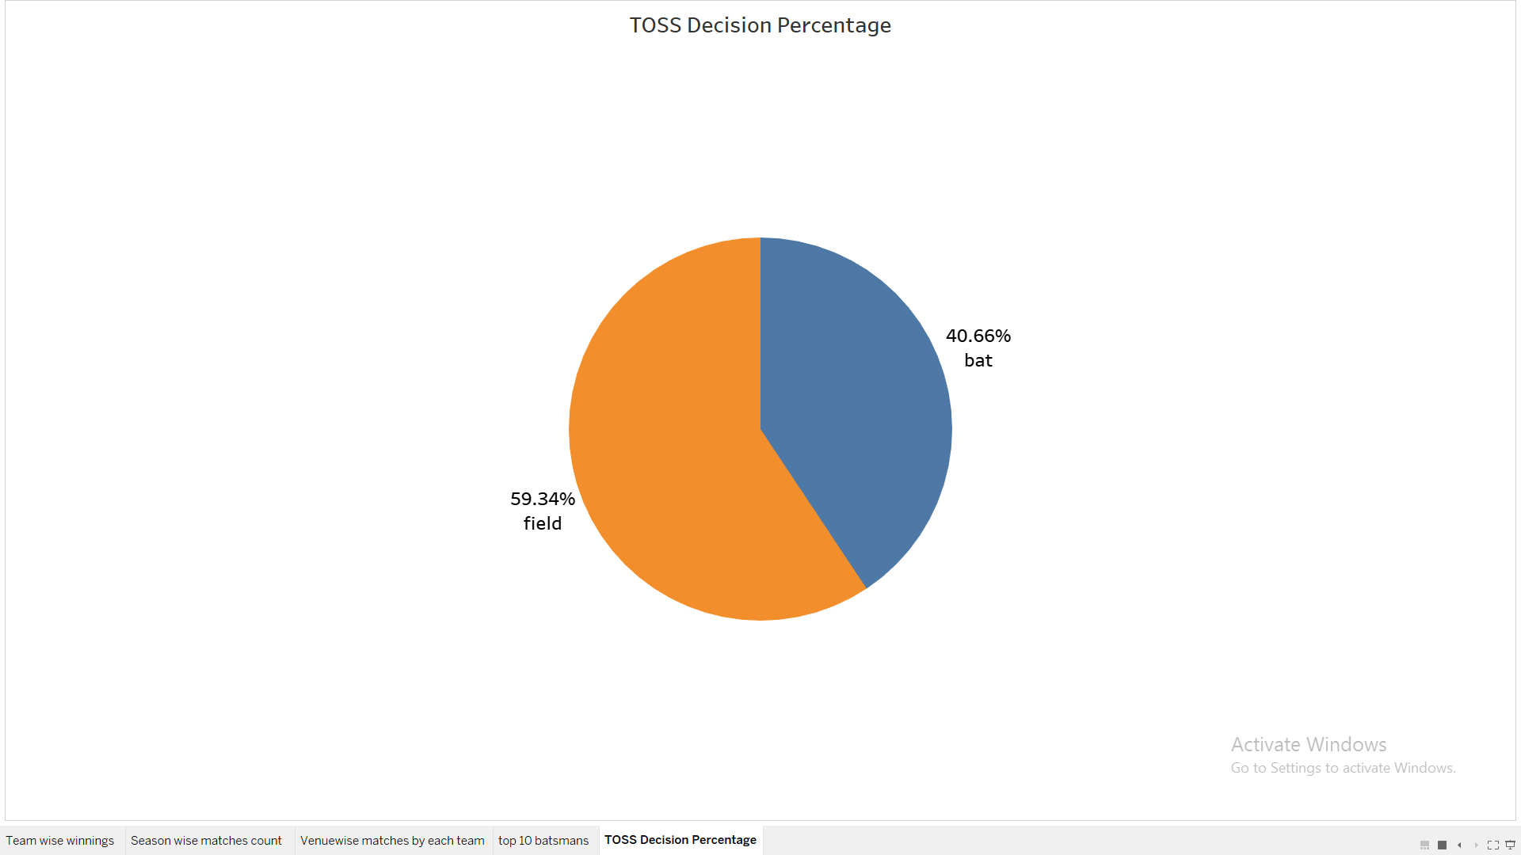
Data Visualization & Representation
Fig: Pie chart Of Toss Decision Percentage

Slide 13
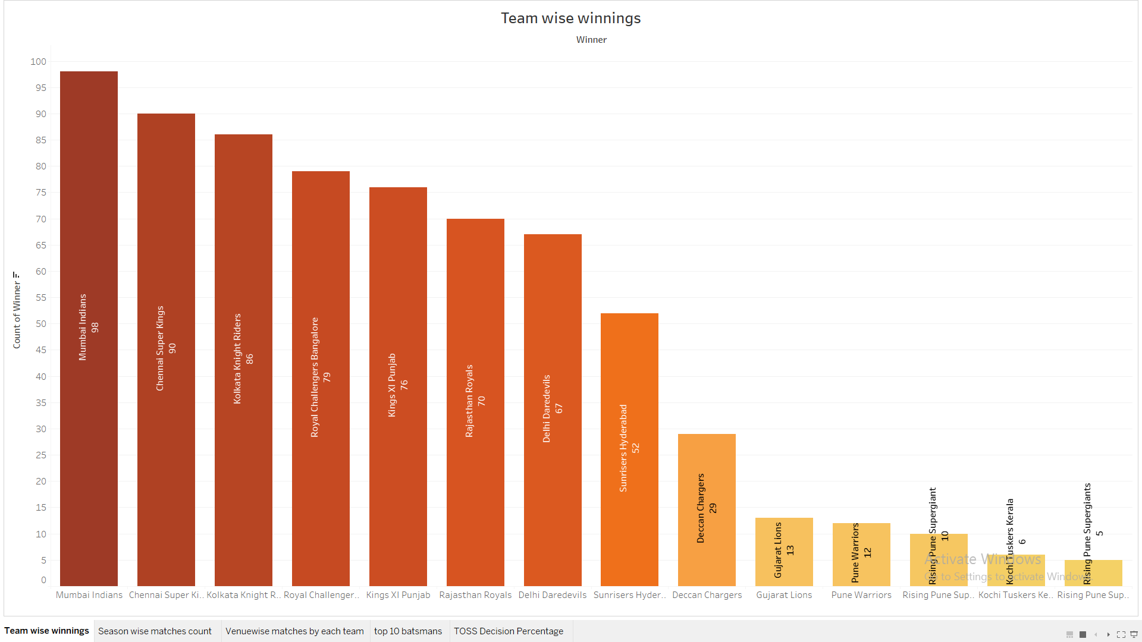
Fig: Bar chart Of Team Wise Winning

Slide 14
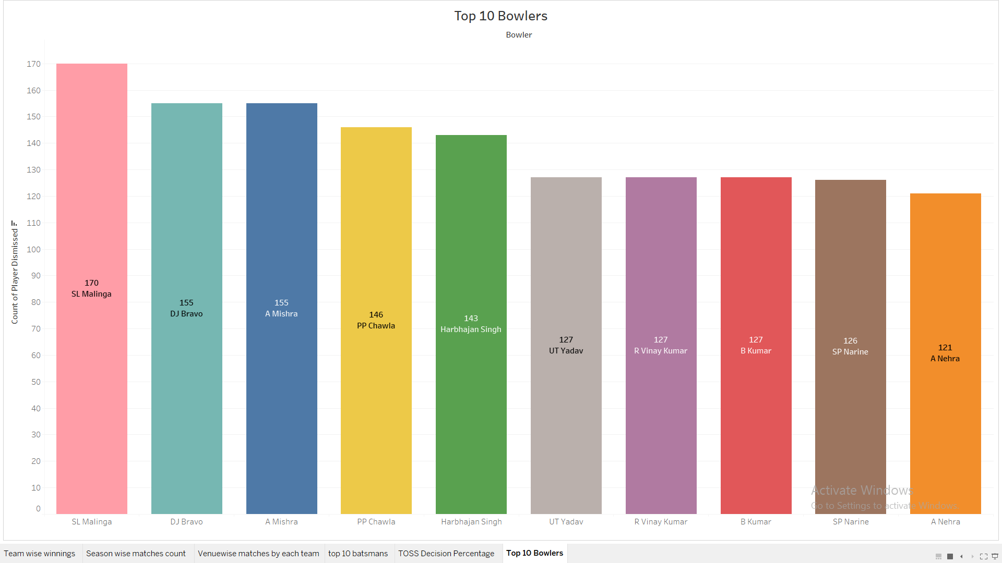
Fig: Bar Chart Of Top Bowlers

Slide 15
Conclusion and Future Scope
This project presented a new machine learning bitcoin price prediction model that combined and implemented machine learning algorithms and generated and predicted a model. To improve the prediction performance, an optimal feature selection process is introduced and demonstrated to have better performance than directly using all the features of available datasets.
27/01/20
15

Slide 16
Bibliography
1. https://www.kaggle.com/giovamata/airlinedelaycauses
2. https://www.slideshare.net/ShubhamGupta577/flight-delay-prediction-model-2
3. https://www.slideshare.net/ColleenFarrelly/machine-learning-by-analogy-59094152
4. R. Britto, M. Dresner, and A. Voltes. The impact of flight delays on passenger demand and societal welfare. Transportation Research Part E: Logistics and Transportation Review, 48(2):460–469, Mar. 2012.
5. Breiman, L., “Random forests,” Machine learning, Vol. 45, No. 1, 2001, pp. 5–32.
6. Hastie, T., Tibshirani, R., and Friedman, J., “Overview of supervised learning,” The elements of statistical learning, Springer,2009, pp. 9–41.
7. Ho, T. K., “The random subspace method for constructing decision forests,” IEEE transactions on pattern analysis and machine intelligence, Vol. 20, No. 8, 1998, pp. 832–844.
27/01/20
16

Slide 17
Thank you for Your Attention!!!
27/01/20
17

